Slide 1
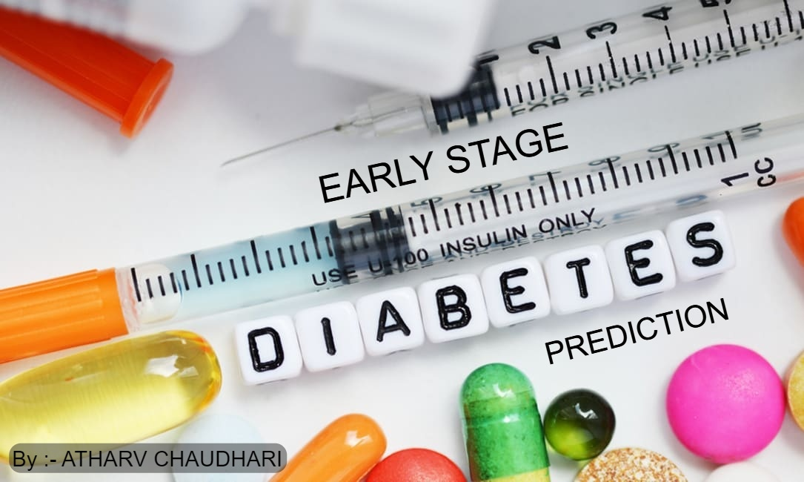

Slide 2
Idea of Project
This Study can help to check whether the patient is diabetes positive or negative on the basis of early stage symptoms of Diabetes.
It is useful for patients to get treatment at early stage of Diabetes and get cured before symptoms become severe.

Slide 3
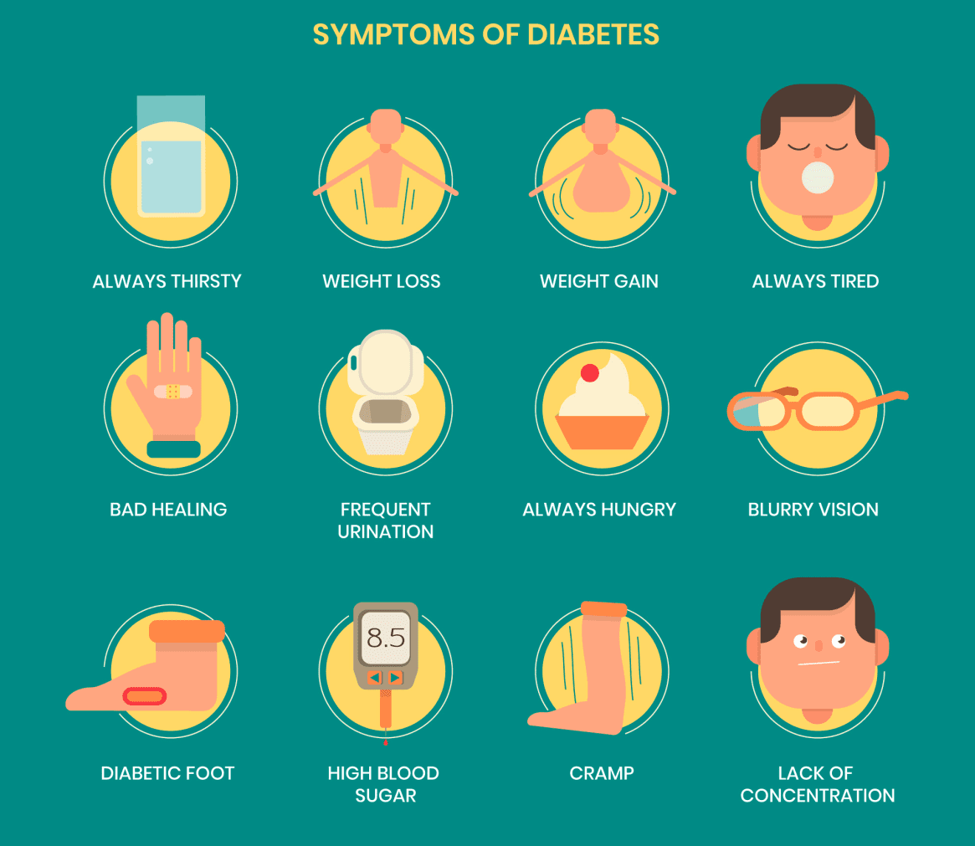

Slide 4
ABSTRACT
Diabetes is a chronic disease that occurs either when the pancreas does not produce enough insulin or when the body cannot effectively use the insulin it produces. Diabetes is diagnosed by measuring the level of glucose in your blood. There are different ways that you can check. A fasting glucose test, a random glucose test and an oral glucose tolerance test are some examples of testing. Fatigue, Blurred vision, dried & itchy skin, frequent urination are some symptoms of diabetes. Here diabetes symptoms categorical data is taken for training and modelling purpose after performing machine learning algorithms like random forest, Xgboost, logistic regression etc. Analysis shows that random forest performs well.

Slide 5
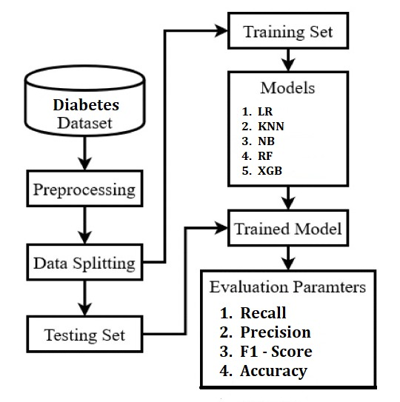
System Architecture

Slide 6
Methodology
Dataset: UCI machine learning repository.
Attributes: Age, Gender, polyuria, Polydipsia, Sudden Weight Loss, Weakness, Polyphagia, Genital Thrush, Visual Blurring, Itching, Irritability, Delayed Healing, Partial Paresis, Muscle Stiffness, Alopecia, Obesity and Class.
Data Preprocessing.
Visualization.
ML Algorithms: Random Forest, Logistic Regression, XgBoost, Naïve Bayes, KNN.
Prediction and choose best model.

Slide 7
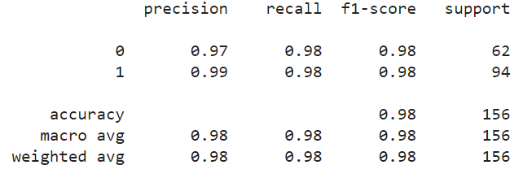
Classification Report of Random Forest Model

Slide 8
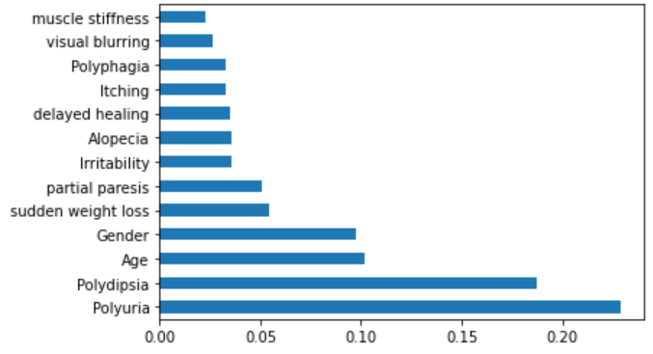
Feature Importance
Feature Importance graph of Random Forest

Slide 9
CONCLUSION
Diabetes is a disease, which can cause many complications. How to exactly predict and diagnose this disease by using machine learning is worth studying. According to all the above experiments, we can conclude that out of all the classification algorithms Random Forest performs well in prediction of diabetes.
In future use of neural network algorithms can be used for better prediction accuracy and more data in the dataset will give exact predictions that will help for betterment in treating patients before the disease becomes more severe.

Slide 10


